Slide 1
Responsive Websites for a better User Experience
CSS Pseudo classes, Responsive Website Layout with Media Query

Slide 2
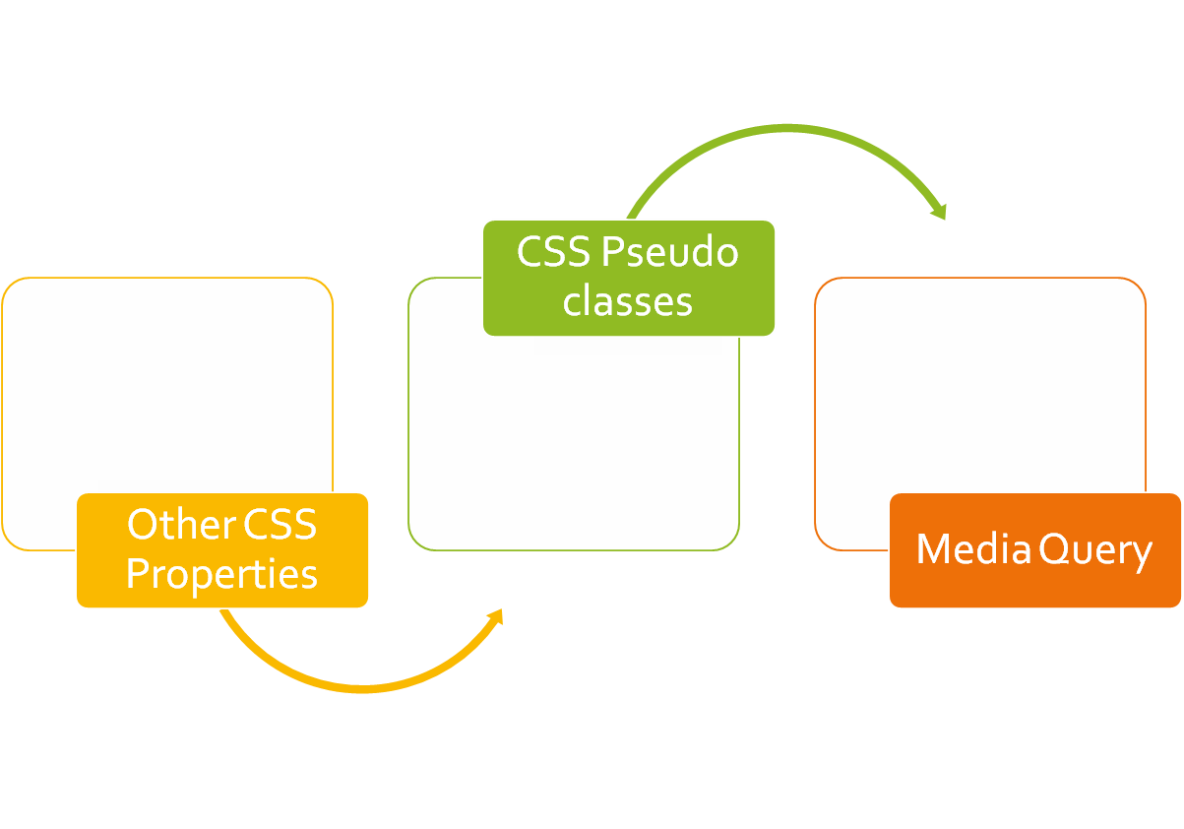
CLASS
OUTLINE

Slide 3
Other CSS Properties and Pseudo classes
Pseudo classes are used to style specified parts of an element. For example, the beginning part of an element, elements when they are selected etc

Slide 4
Other CSS Properties
line-height : can be used to specify the vertical distance between a line of text and the one coming after it.
p {
line-height:20px;
}
A common application of the line-height is to vertically centralize content that exists alone within a container. For Example: the copyright statement within a footer. The trick is to set the element’s line-height to the same as its height: see the below without and with line-height set
#demo{
height:100px;
line-height:100px;
}

Slide 5
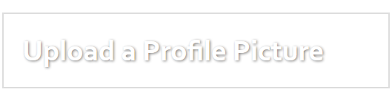
Other CSS Properties
The text-shadow property applies shadow to each of the character in the text, Internet Explorer 9 and earlier versions, do not support the text-shadow property.
Syntax: text-shadow: horizontal amount vertical amount blurr amount color eg 2px 3px 6px red;
You can combine multiple shadow in one line by separating the h v b color with comma (see notes for example)
The box-shadow property applies shadow to elements. Syntax is like that of text-shadow. Example: box-shadow: 10px 10px 5px grey;
Notes:
h1{
box-shadow:3px 3px 5px red, 6px 6px 5px blue ;
}
h1{
text-shadow:1px 1px 2px grey;
color:white;
border:2px solid #ddd;
padding:20px;
width:35%;
}

Slide 6
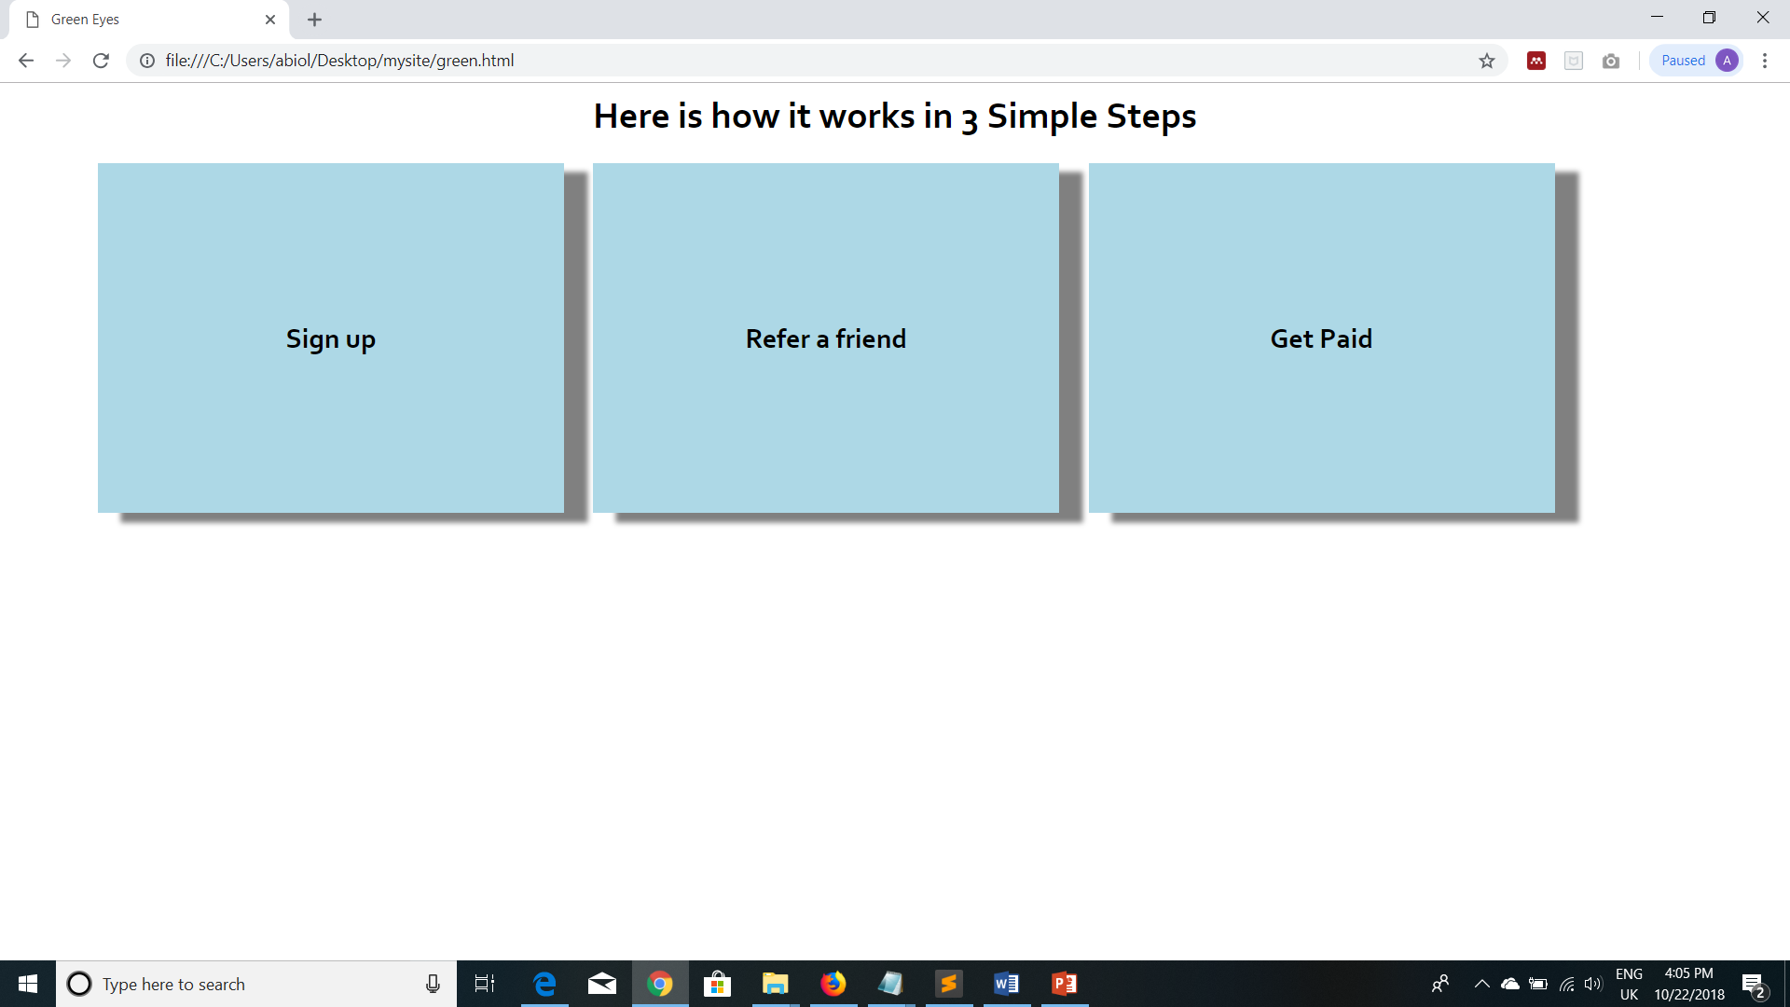
Classwork: Using box-shadow property, achieve something similar to this >

Slide 7
Pseudo Classes
Pseudo classes are used to style specified parts of an element. For example, the beginning part of an element, elements when they are selected etc
General Syntax is: selector::pseudo-element {
property:value;
}
::first-line, ::first-letter
::before and ::after can be used to insert some contents before and after the content of an element.
Syntax is selector::before{content: url(‘’)}
::selection pseudo-element matches the portion of an element that is selected by a user.

Slide 8
The hover state
General Syntax is:
selector:hover {
property: value;
}
The hover pseudo-selector is used to target an element in its hover state, that is: when the user mouses over the element.
It can be applied to any element * but it’s usually applied to the <a> tag to specify different rules based on the state of the link.
In addition to the :hover state, the <a> tag responds to other states such as :active, :link, :visited.
:hover MUST come after :link and :visited (if they are present)
Notes:
tr:hover {/* rule for when the table is moused over */}
img:hover {/* rule for when the image is moused over */}

Slide 9
Other CSS Properties
a:active{}
border-collapse: collapse; (Tables)
tr:nth-child(odd){}
tr:nth-child(even){}
tr:hover{}
letter-spacing: 10px;

Slide 10
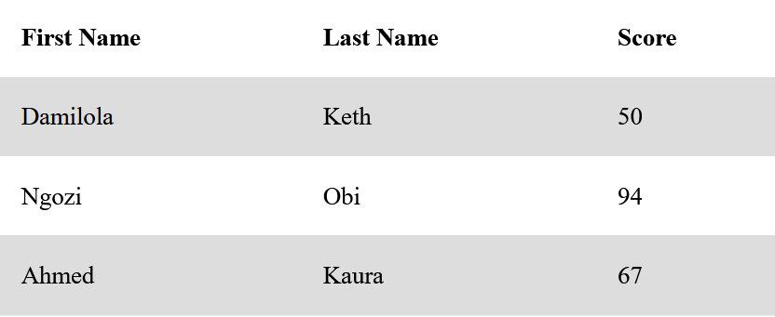
Using the tr(nth) property, reproduce the table below

Slide 11
Other CSS Properties
!Important
When there is a clash of rule, specifying a rule definition as important makes it OVERRIDE all previous rules.
p{
  font-size:12px !important ;
}
Note that important declaration comes before the terminating semi colon

Slide 12
Other CSS Properties
@import : allows you to import a style sheet into another style sheet; The @import rule must be at the top of the document.
Basic syntax:
  @import "navigation.css";
  or
  @import url("navigation.css");

Slide 13
Other CSS Properties
Adjacent Sibling Selector (+) is used to select the elements that are placed immediately after the specified element but not inside the particular elements.
  element + element {
  // CSS property
  }
Example:
<!- - HTML- - > <h2 id=“demo”>Hello</h2> <h2>Beautiful World!</h2> <h2>Welcome to My World…</h2 | /*CSS*/ #demo + h2{ color:red; }

Slide 14
Inherit value
<body>
<p> I am a sample text</p>
</body>
A child element can inherit values from its parent element with the inherit value
<style type=“text/css”>
body{
height: 100px;
}
p{
height : inherit; /*means the p tag also has a height of 100px*/
}
</style>

Slide 15
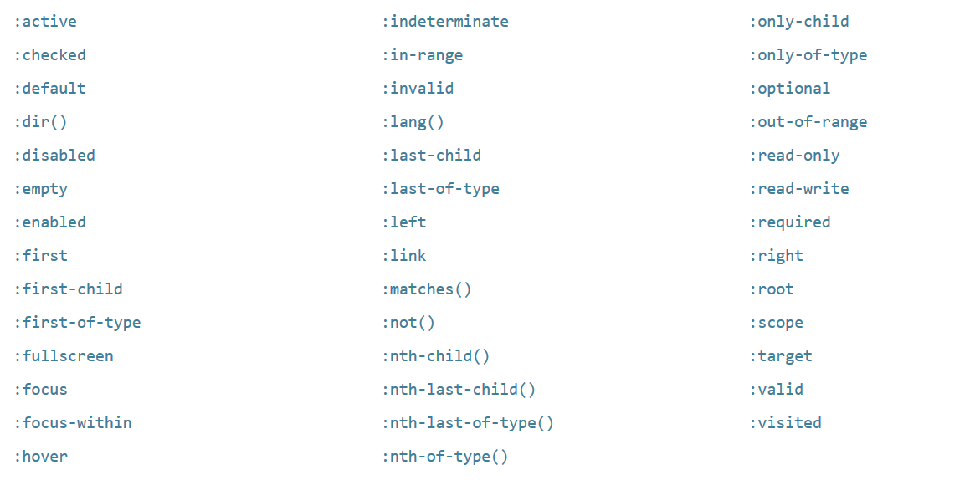
Go Further!

Slide 16
Media Queries
The @media rule, allows us to define different style rules for different media types and/or different screen sizes.

Slide 17
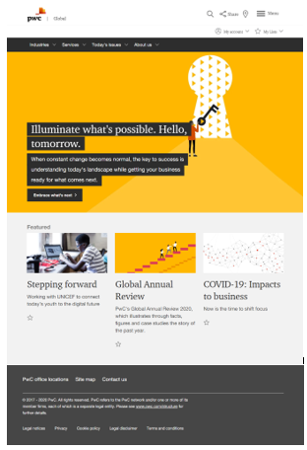
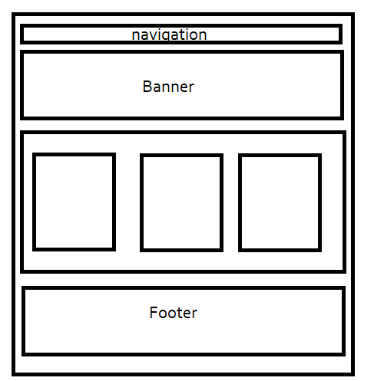
Consider PWCs website and the sketch

Slide 18
Simulating Mobile view in your browser
Include the meta tag for responsiveness as below:
<meta name="viewport" content="width=device-width, initial-scale=1, shrink-to-fit=no">
Mozilla Firefox: ctrl+shift+M
Chrome: Ctrl+Shift+I or right click the page and select inspect element, select the mobile phone icon
Opera: Similar step as Google Chrome above

Slide 19
Why Responsiveness?
Before mobile phones and other smart devices became common, websites were accessed through desktop computers and then Laptops.
Same resolution across all computers hence websites had fixed widths.
Sideways scrolling is not as convenient as vertical scrolling.
To be responsive-ready, your webpage must include the meta tag for viewport

Slide 20
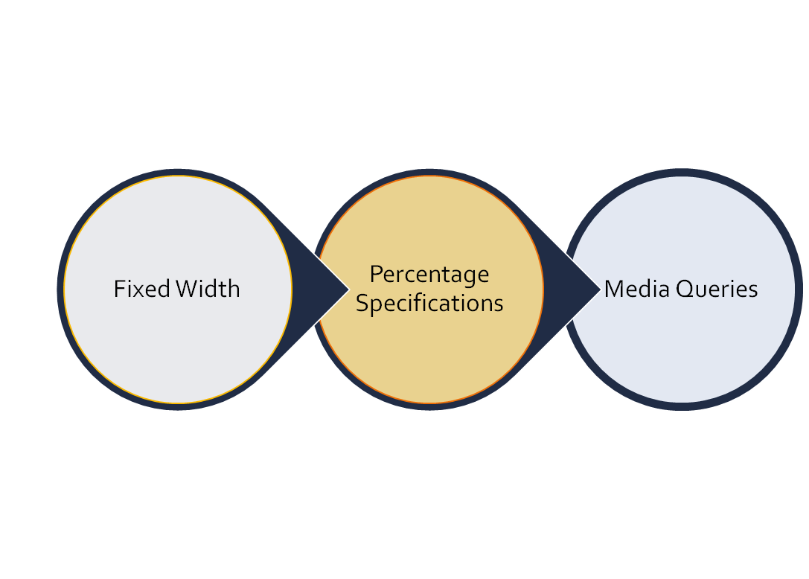
EVOLUTION OF WEBSITE
RESPONSIVENESS

Slide 21
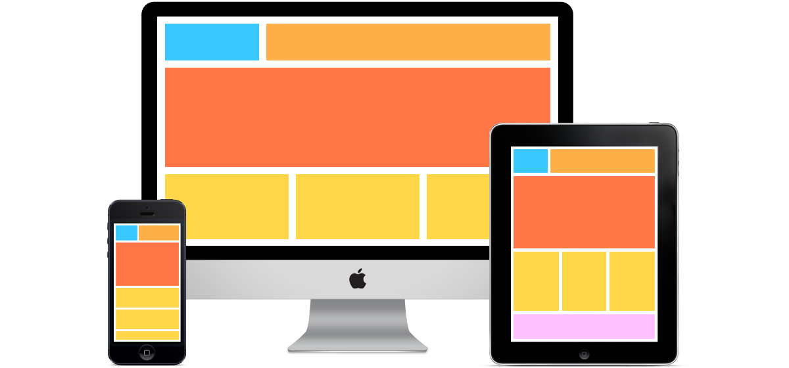
Definition
Responsive websites are websites that can adapt to the screen of any device…

Slide 22
Required Meta Tag
<meta name="viewport" content="width=device-width, initial-scale=1, shrink-to-fit=no">

Slide 23
Media Query Syntax
@media mediatype and (expressions) {
CSS-Code;
}
mediatype may be: all, print, screen, speech
Example:
@media screen and (min-width: 480px) {
body {
background-color: lightgreen;
}
}
The mediatype is used to specify when the rule should be applied. For example, print means that the rule should only apply when the page in question is being printed; the output from the printer

Slide 24
Media Query Syntax
You can use media queries to change the font size of an element on different screen sizes:
For example, if screen size is more than 600px wide, set the font-size of <div> to 80px
You can also use the (max-width: ..) and (min-width: ..) values to set a minimum width and a maximum width as follows:
@media screen and (max-width: 900px) and (min-width: 600px) {
      div {font-size:80px;}
  }
You can specify a different height when the screen size is smaller. Etc

Slide 25
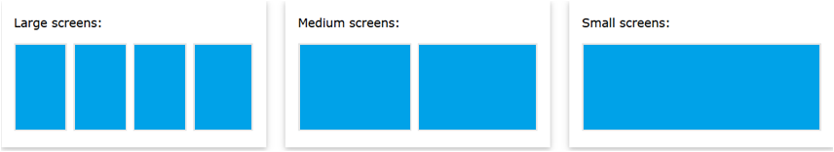
Media Query Syntax (Flex)
A common use of media queries, is to create a flexible [responsive] layout when the screen size varies as shown in the image below:
.parent { display: flex; }
.child{ width: 25%;}
See Notes for more
Notes:
/* On screens that are 992px wide or less, go from four columns to two columns */
@media screen and (max-width: 992px) {
.parent{
flex-wrap:wrap;
}
.child{
width: 50%;
}
}
/* On screens that are 600px wide or less, make the columns stack on top of each other instead of next to each other */
@media screen and (max-width: 600px) {
.parent{flex-direction: column}
.child {
width: 100%;
}
}

Slide 26
Responsive Layout: Big Challenge?
Of all the device type in the world, how many device size do we want to create rules for?

Slide 27
Media Query Cheat Sheet
Devices are generally categorized into the following breakpoints: - 1280, 1024, 768, 480
  1280-1024 - desktop (default grid)
  1024-768 - tablet landscape
  768-480 - tablet
  480-less - phone landscape & smaller devices
Check media query template - https://gist.github.com/gokulkrishh/242e68d1ee94ad05f488

Slide 28
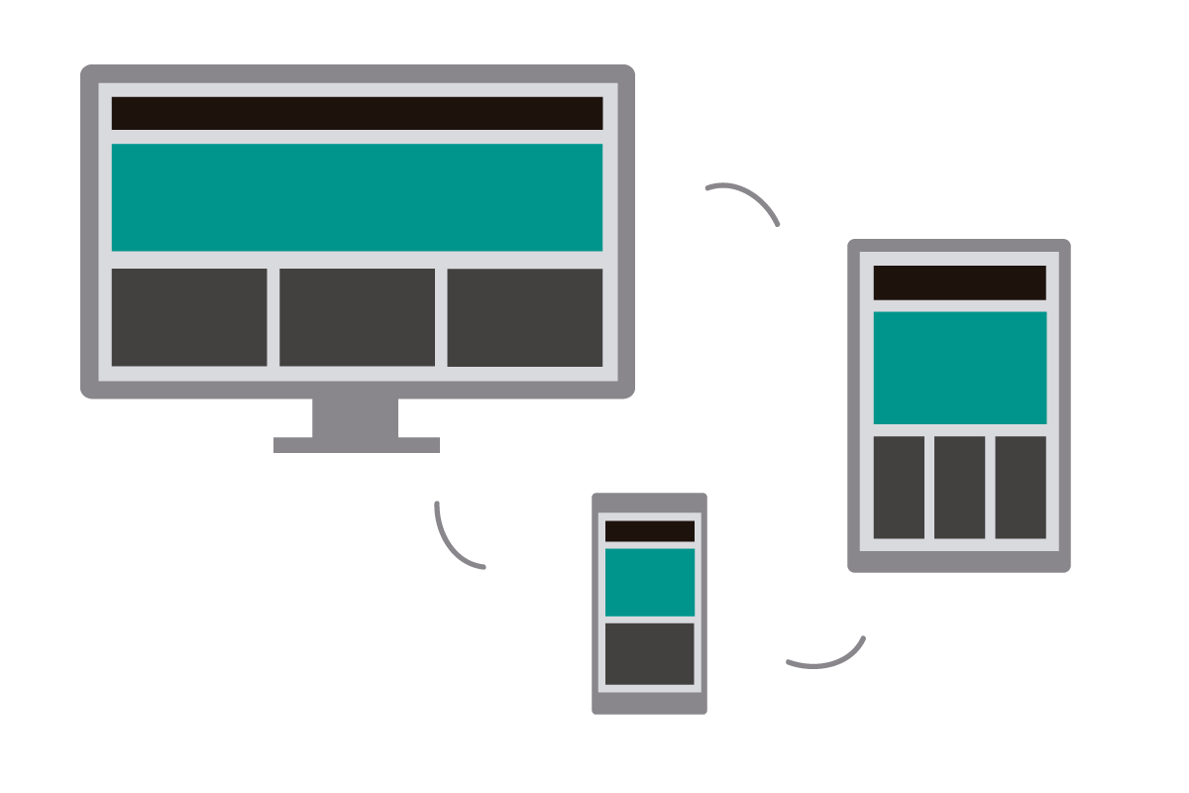
Hands-on: How do you achieve the following? *
Notes:
On regular device, the divs stand side by side : This can be accomplished by floating each of them
Using media query, we can specify that on small devices, each of the div should stand as a block element and take width of 100% without floating.
You can use float:none;

Slide 29
Last Minutes Fine-tuning
Removal of outlines
www.moatacademy.com

Slide 30
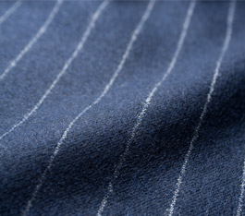
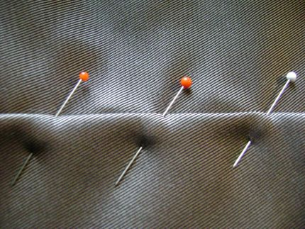
How will you feel if your tailor tells you your cloth is ready but you find chalks and pins all over?
If you will not be happy, your clients too won’t

Slide 31
Wireframes and Design
Border lines provide you a good outline when designing your website
They help you visualize the end products more easily
Some people can use border properties or a solid background to serve as differentiating factors across the different ‘boxes’ on their webpage
But THEY SHOULD BE REMOVED when you are done with the design

Slide 32
Mini Project

Slide 33
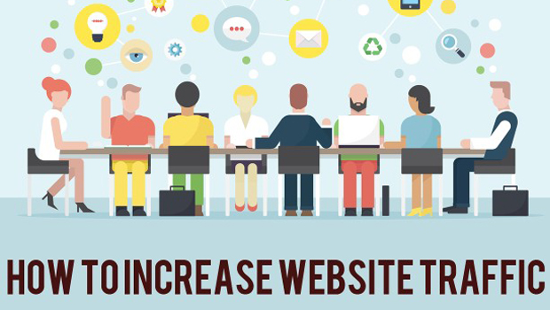
A company has been having series of meeting on how they can increase their website traffic

Slide 34
Week Two Mini project
You have been approached as a web designer to help re-design their current website to be beautiful and SEO friendly so that they can attract more customers
Produce the design concept, a minimum of 3 pages is expected – home page, contact us and any other page such as about us.
Make it responsive as much as you can
Useful resources:
  http://coolors.co for color mix
  http://fontpair.co and https://google.com/fonts to get fonts
  https://www.flaticon.com/ to get icons
  https://pixabay.com to get free HD images

Slide 35

Feeling like it already?
A professional website designer!
A total commitment is a paramount to reaching the ultimate in performance. ~ Tim Flores

